Slide 1
Constructive Cost Model
Software Project Cost Management

Slide 2
What is COCOMO?
Boehm proposed COCOMO (Constructive Cost Model) in 1981.
COCOMO is the abbreviation of the Constructive Cost Model.
COCOMO predicts the effort, cost and schedule of a software product based on the size of the software(number of Lines of Code).
Effort: Amount of labor that will be required to complete a task. It is measured in person-months units.
Schedule: Simply means the amount of time required for the completion of the job, which is, of course, proportional to the effort put. It is measured in units of time such as weeks, or months.

Slide 3
Three levels of Project
The COCOMO model can be applied to three types of software projects:
Organic project: An organic software project requires a small team, the problem is well understood, and the team members are experienced in developing similar projects. e.g. small data processing systems, basic inventory management systems, business systems.
Semi-detached project: A semi-detached project is medium-sized, with the development team consists of a mix of experienced and inexperienced staff, and the major characteristics of the project lie in between organic and embedded. e.g. Database Management System(DBMS), new unknown operating system, difficult inventory management system.
Embedded project: An embedded software project has a high level of complexity, requiring a large-sized experienced team, and is coupled with complex hardware.

Slide 4
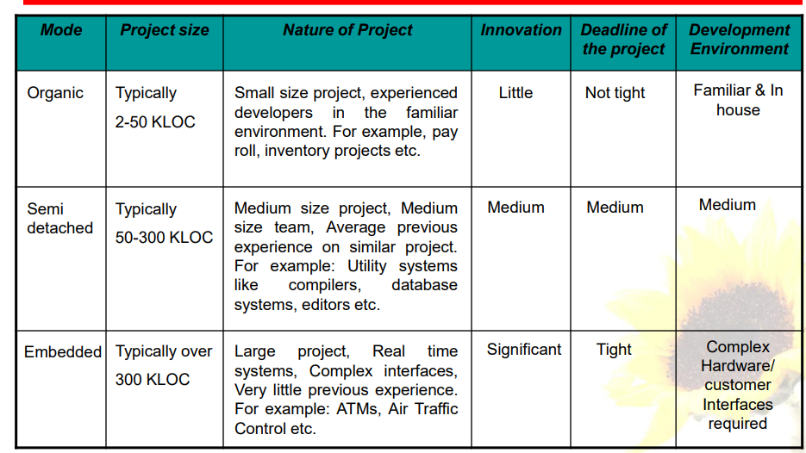
Comparison Between Three levels of Software Project

Slide 5
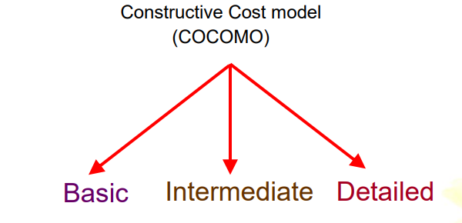
Types of COCOMO models
The COCOMO model is divided into three types based on the accuracy quotient. Any of the three types can be adapted according to our requirements:
Basic model
Intermediate model
Detailed model

Slide 6
Basic COCOMO
The basic model is used for quick and rough cost calculations for the software. It calculates the effort, time, and number of people required.
It focuses on project size and development methods.
Project size:
The size of a software project is usually measured in lines of code (LOC), which represents the total number of lines of code to be written.
Development methods:
The Basic COCOMO model defines three development states that describe the different complexity of projects and the capabilities of the team:
Organic mode: For small teams working with familiar software.
Semi-detached Mode: For medium-sized groups working with somewhat familiar software.
Embedded mode: For large teams working with complex and unfamiliar software.

Slide 7
Basic COCOMO
The basic COCOMO estimation model is given by the following expressions:
E = a*(KLOC)^{b}
Tdev = c*(E)^{d}
Person required/Staff size = Effort/ Time
Where,
E is effort applied in person-months. D is development time in months. P is the total no. of persons required to accomplish the project.

Slide 8
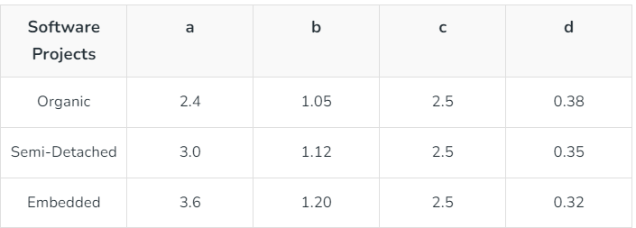
Basic COCOMO
The constant values a, b, c, and d for the Basic Model for the different categories of the system:

Slide 9
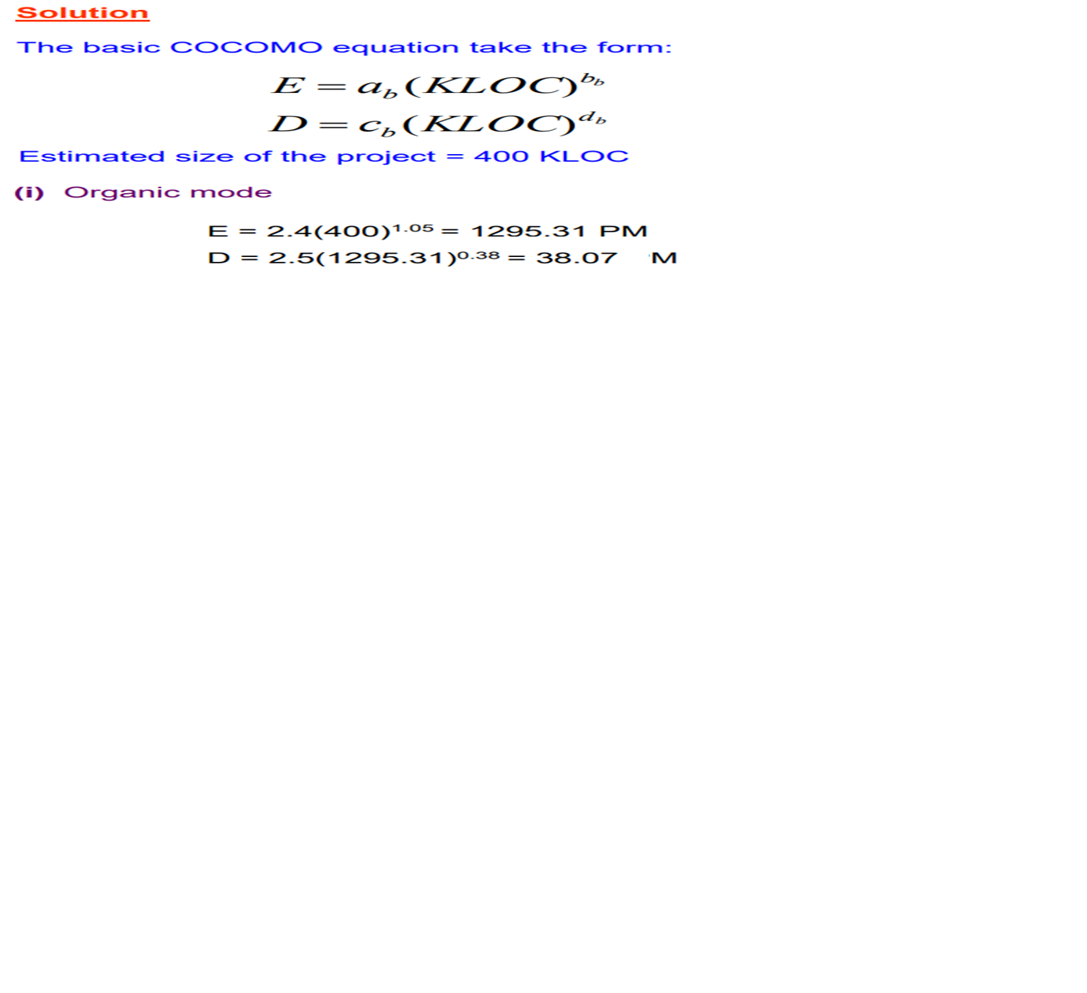
Example
Suppose that a project was estimated to be 400 KLOC. Calculate the effort and development time for each of the three modes i.e., organic, semidetached, and embedded.

Slide 10
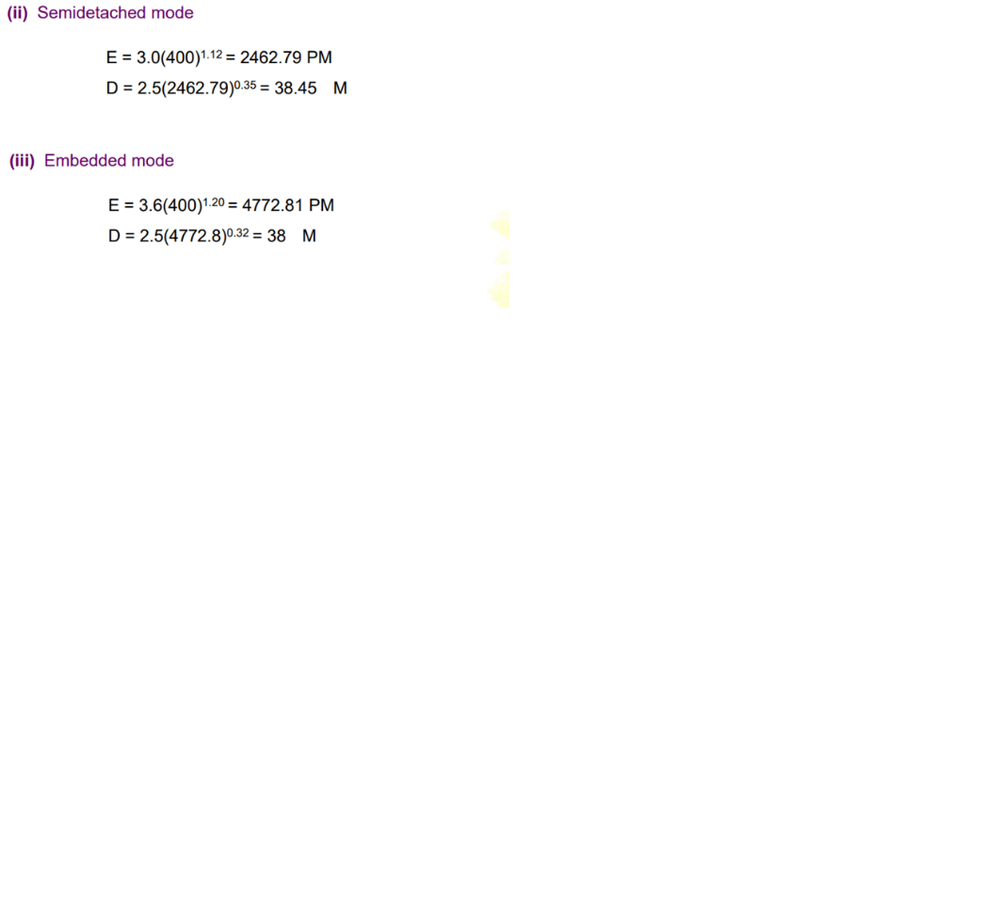
Example

Slide 11
Exercise 1
A project size of 200 KLOC is to be developed. Software development team has average experience on similar type of projects. The project schedule is not very tight. Calculate the effort, development time, average staff size of the project.

Slide 12
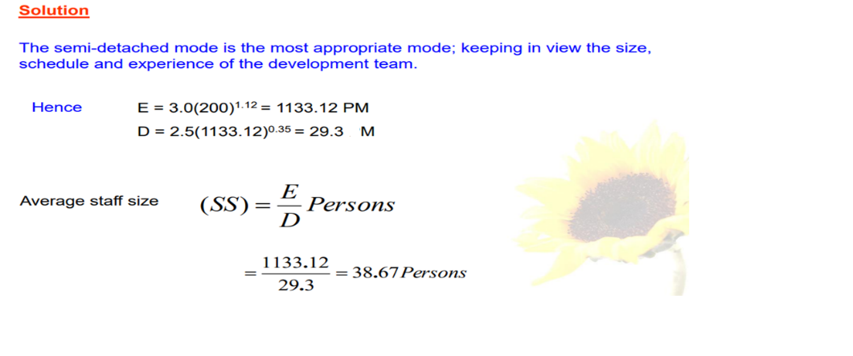
Solution

Slide 13
Exercise 2
A medium-sized software company is developing an inventory management system for a client. The project has moderate complexity, and the company has partial experience with similar projects. The estimated size of the project is 100 KLOC.
Using the basic COCOMO model, calculate the estimated effort (in person-months), development time (in months), and average staff size for the project.

Slide 14
Exercise 3
A small e-commerce start up wants to develop a basic online shopping platform. The project is straightforward, with a well-defined and familiar environment. The estimated size of the software project is 20 KLOC (thousands of lines of code).
Calculate the estimated effort (in person-months), development time (in months), and average staff size required for the project.

Slide 15
Exercise 4
A government agency requires a mission-critical software system for national defense. This project is highly complex and must meet stringent performance and reliability requirements. The estimated size of the project is 500 KLOC.
Using the basic COCOMO model, Calculate the estimated effort (in person-months), development time (in months), and average staff size for the project.

